Slide 1
Basic Light Field
ShanghaiTech CS 276

Slide 2
Camera Array
Capture a set of images
Capture a set of rays
Any differences between a camera and a camera array?
A 3D point can be seen multiple times by a camera array!
MIT Camera Array
Stanford Camera Array

Slide 3
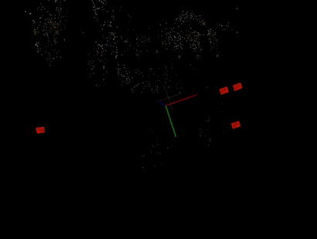
Application: Novel View Synthesis
Explicit geometry(3D Reconstruction)
Structure from motion
Multi-view stereo
No geometry(Image-based Rendering)
Light field
Lumigraph
Implicit geometry (Neural Rendering)
Neural Volumes
Neural radiance field (NeRF)

Slide 4
Basic idea of Light field
Novel view synthesis
Novel view rays
Query from ray database
Interpolate a ray if it does not exist

Slide 5
How to represent a light field?
How to represent a ray in 3D space:
Two points on the line (3D + 3D = 6D)
A point and a direction (Euler angle) (3D + 2D = 5D)
Any better Parameterization?

Slide 6
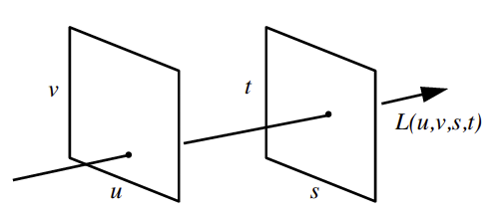
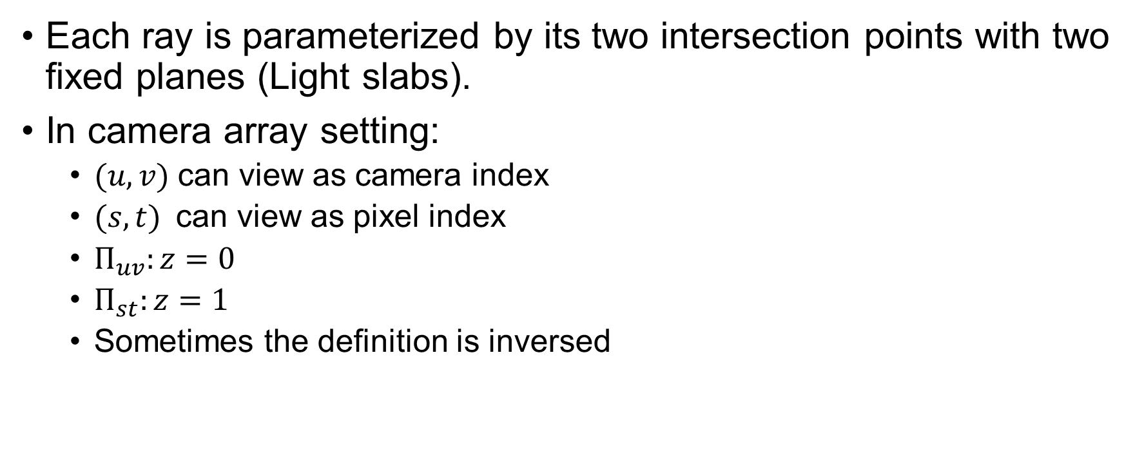
Two Plane Parameterization
Each ray is parameterized by its two intersection points with two fixed planes (Light slabs).
In camera array setting:
$(u, v)$can view as camera index
$(s, t)$can view as pixel index
$Π_{uv}:z=0$
$Π_{st}:z=1$
Sometimes the definition is inversed
Light slab representation

Slide 7
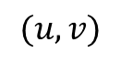
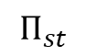
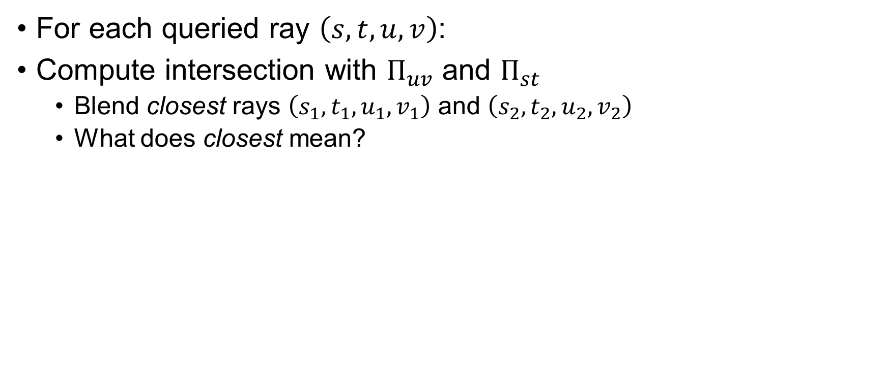
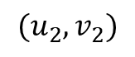
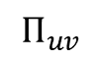
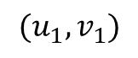
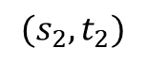
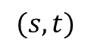
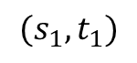
Light Field Rendering
For each queried ray $\left(s,t,u,v\right)$:
Compute intersection with $Π_{uv}$ and $Π_{st}$
Blend closest rays $\left(s_{1},t_{1},u_{1},v_{1}\right)$ and $\left(s_{2},t_{2},u_{2},v_{2}\right)$
What does closest mean?
$$(u_{1},v_{1})$$
$$(u,v)$$
$$(u_{2},v_{2})$$
$$Π_{uv}$$
$$Π_{st}$$
$$(s_{1},t_{1})$$
$$(s,t)$$
$$(s_{2},t_{2})$$

Slide 8
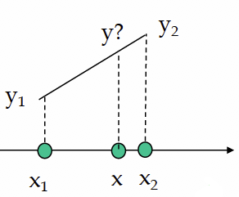
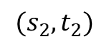
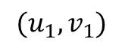
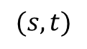
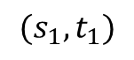
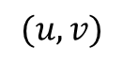
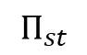
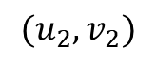
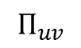
Light Field Rendering
Blending: Linear Interpolation
For 1D Function:
What happens to a higher dimension?
Bilinear, Tri-linear, Quadra-linear
$$(u_{1},v_{1})$$
$$(u,v)$$
$$(u_{2},v_{2})$$
$$Π_{uv}$$
$$Π_{st}$$
$$(s_{1},t_{1})$$
$$(s,t)$$
$$(s_{2},t_{2})$$

Slide 9
Quadra-linear Interpolation
Serious aliasing artifacts

Slide 10
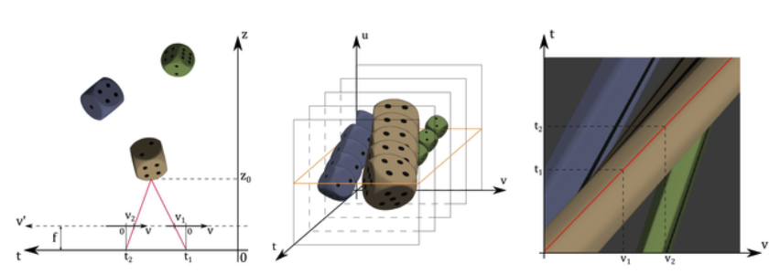
Stack images along t
t1, t2 is camera position
Fix u, yellow plane is epipolar plane image (EPI)
EPI

Slide 11
Focal Plane Parameterization
Trace ray to the focal plane
Trace back to the references
Quadra-linear interpolation
Need to do ray-plane intersection
Can we avoid that in camera array?

Slide 12
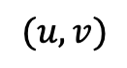
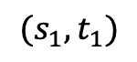
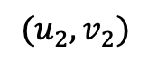
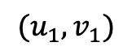
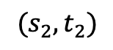
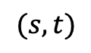
Using camera array property
$$\left(u_{i},v_{i}\right)=\left(u,v\right)+disparity × \left(s_{i}−s,t_{i}−t\right), i=1,2,3,4$$
Focal Plane
$$(u_{1},v_{1})$$
$$(u,v)$$
$$(u_{2},v_{2})$$
Image Plane
Camera Plane
$$(s_{1},t_{1})$$
$$(s,t)$$
$$(s_{2},t_{2})$$

Slide 13
Results
Quadra-linear
Focus on monitor

Slide 14
Aperture Filtering
Simple and easy to implement
Cause aliasing
Can we blend more than 4 neighboring rays? 8, 16, 32? Or more?

Slide 15
Variable Aperture

Slide 16
Changing the shape & size of aperture filter

Slide 17
Small Aperture Size

Slide 18
Large Aperture Size

Slide 19
Very Large Size Aperture
Looking through the object

Slide 20
Variable Focus

Slide 21
Issues with Light Field
It only captures rays within a region (volume)
It is huge (needs compression)
If implemented using software, a lot of memory fetches
Solution 1: multitexturing
Solution 2: using graphics hardware

Slide 22
Better Reconstruction Method
Assume some geometric proxy
Dynamically reparametrized light field

Slide 23
Close Focal Surface

Slide 24
Distant Focal Surface

Slide 25
The Lumigraph
Capture: move camera by hand
Camera intrinsics assumed calibrated
Camera pose recovered from markers

Slide 26
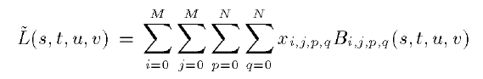
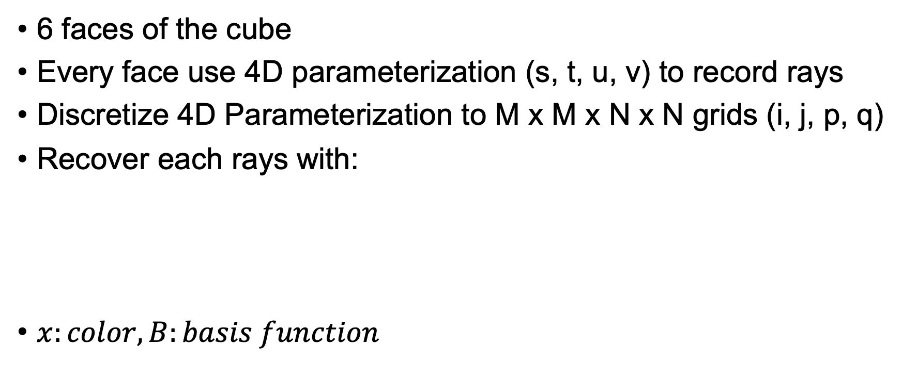
Parameterization of the 3D space
6 faces of the cube
Every face use 4D parameterization (s, t, u, v) to record rays
Discretize 4D Parameterization to M x M x N x N grids (i, j, p, q)
Recover each rays with:
$x:color, B:basis function$

Slide 27
Lumigraph Postprocessing
Obtain rough geometric model
Chrome keying (blue screen) to extract silhouettes
Octree-based space carving
Resample images to two-plane parameterization

Slide 28
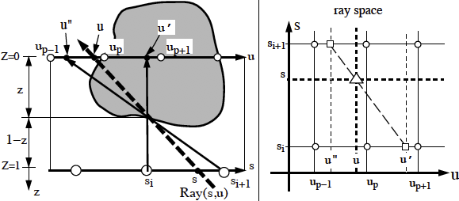
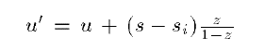
Lumigraph Rendering
Use rough depth information to improve rendering quality

Slide 29
Lumigraph Rendering
Without using geometry
Using approximate geometry

